Slide 1

Trusted Communication in Software Defined Distributed Systems

Slide 2

Abstract
The internet, since the advent of ARPANET, has come along a very long
way. It has undoubtedly changed millions of lives and even now is in its
infancy. Software Defined Networking (SDN) is presented as a paradigm
shift in this regard. It strives to standardize the networking on all levels. This
is an initiative to redesign the current networking stack and
compartmentalize into three main planes, the data plane, the control plane
and the management plane, respectively moving from bottom up. We, here,
have put an effort to augment the idea of SDN to a more distributed
framework. Using cleverly designed topologies like Spine leaf, we
demonstrate the interconnection of controllers using relay system designed
from bottom up as the first phase. The second phase, on other hand,
acknowledges the need to secure such translations and we try to mitigate
Denial of Service (DoS) attacks on the control plane.

Slide 3
What are Software Defined Networks?
In a software-defined network, a network engineer or administrator can shape traffic from a centralized control console.
The centralized SDN controller directs the switches to deliver network services wherever they're needed.
A typical representation of SDN architecture comprises three layers: the application layer, the control layer and the infrastructure layer.

Slide 4
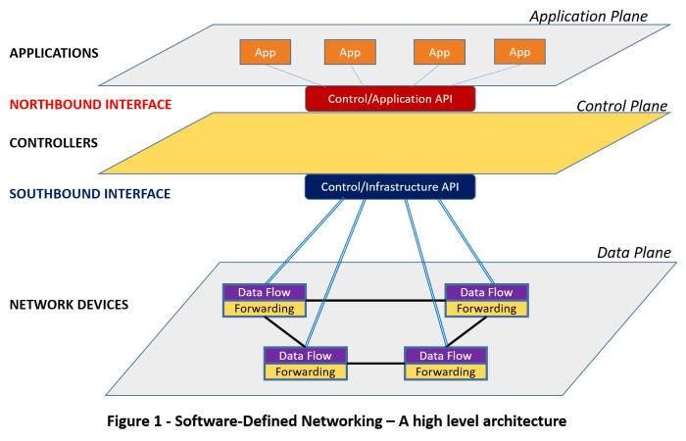
SDN Architecture

Slide 5
Introduction
This is an initiative to redesign the current networking stack and compartmentalize into three main planes, the data plane, the control plane and the management plane.
Using cleverly designed hybrid topologies, we demonstrate inter-controller connection in a distributed environment in first phase.
The second phase acknowledges the need to secure such translations and we try to mitigate Denial of Service (DoS) attacks on the control plane.

Slide 6
Current Situation
Current SDN industry standard controller implementations do not inherently support distributed inter-controller communication.
Some of them who do, use infeasible and expensive mesh topologies.
SDN, thus, is limited to single controller and non-scalable networks.
Inter-controller communication of different types is also a problem.

Slide 7
Limitations of Current System
Less scalability factor.
More energy consumption.
Greater expense for physical cables.
More vulnerable area to secure.
(n-1)^{n} connections within controllers due to Mesh topology.

Slide 8
Proposed System
We propose a relay to act as a bridge between the controllers in a distributed system.
The relays can be sub-relayed as per geographical requirements.
Controllers use relay as proxy to broadcast flow query in the network.
A duplex connection between each controller and relay facilitates simultaneous broadcast and reply.
Bottlenecks are eliminated using frequent multi threaded constructs.
A TCP server listening for particular connections at controller handler, relay and controller as well for the duplex connection.
Python/java has been used as controller implementation language to interface with dynamic shared libraries coded in pure C, while relay engine remaining in pure C.

Slide 9
Review 1

Slide 10
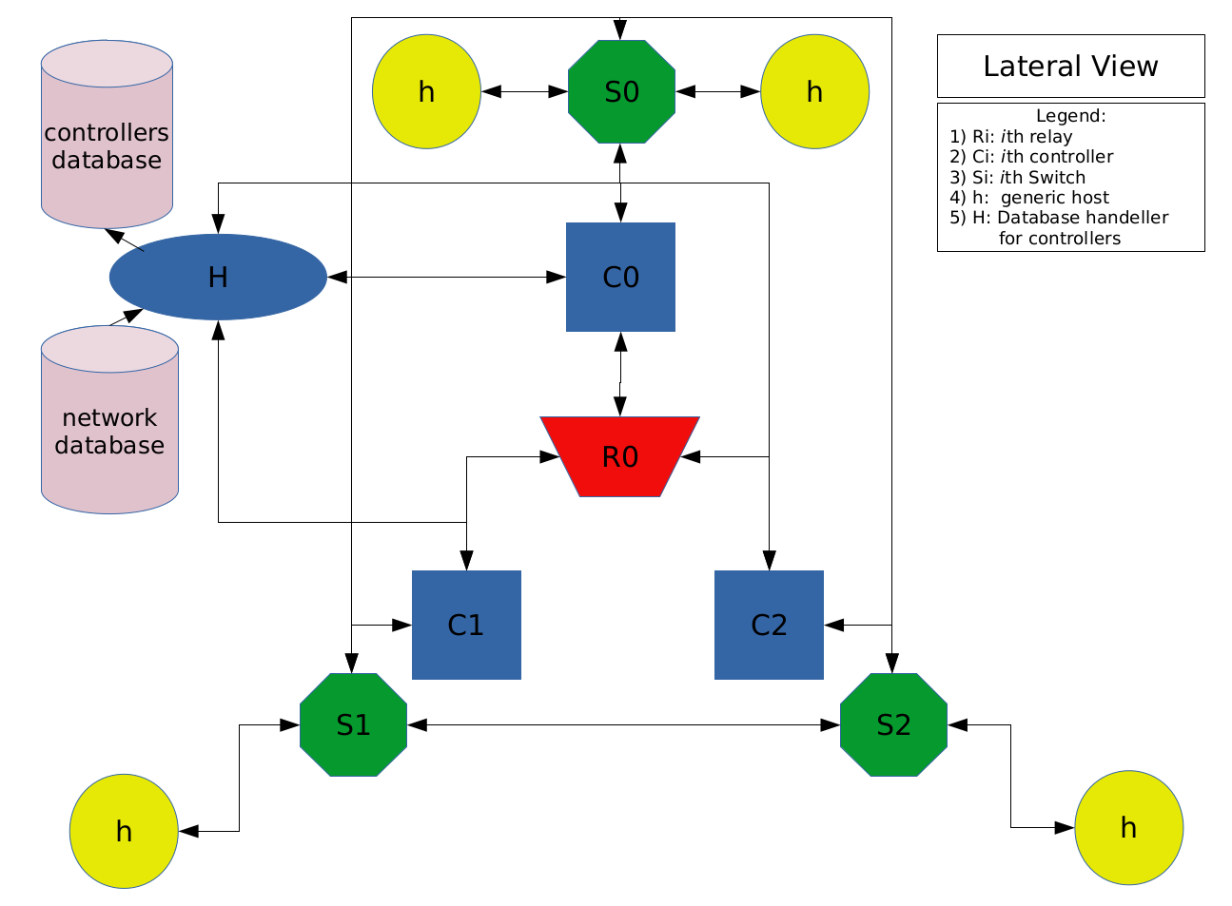
Designed Architecture

Slide 11
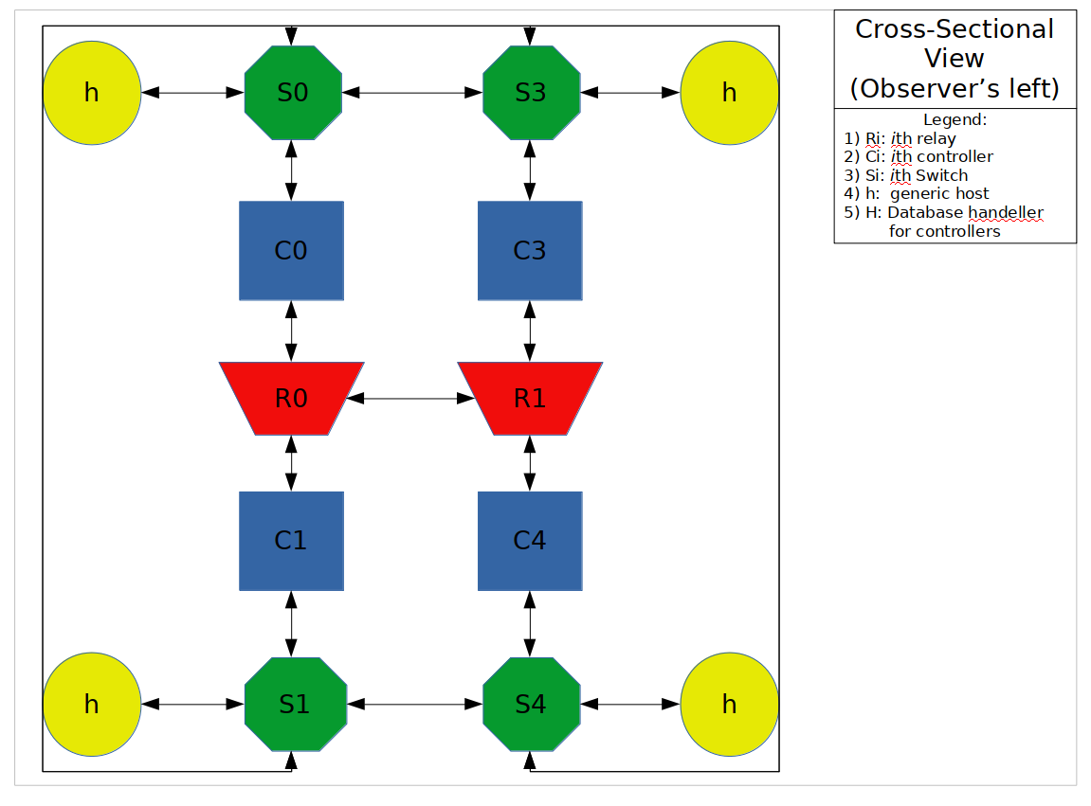

Slide 12
How the Architecture works?
Database docker image starts
Controller handler start connecting to ‘controllers’ database.
Controllers boot sending information to controller handler to be registered.
Topology simulator fetches the Controller Database
User Input for the required number of hosts and switches.
Random pairing for switches and hosts using the libsodium library.
Random number of hosts connected to the switches.
Topology is described as a 3d array, where the entries in database are separate tables with each controller has a separate table with its IP as the name for each table.
Class A Ips are automatically assigned by the Mininet.
Static Ips assigned to each controller on connection.
Standalone controller connection through relay.
Network database accessed by controller upon the connection.

Slide 13
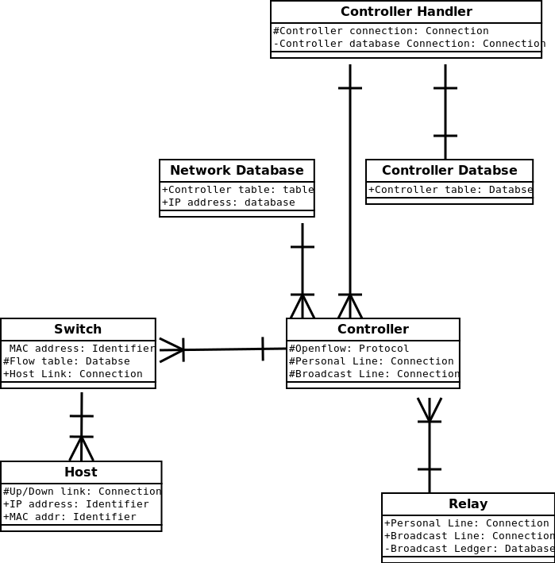
Workflow

Slide 14
Review 2

Slide 15
Some updations in Architecture

Slide 16
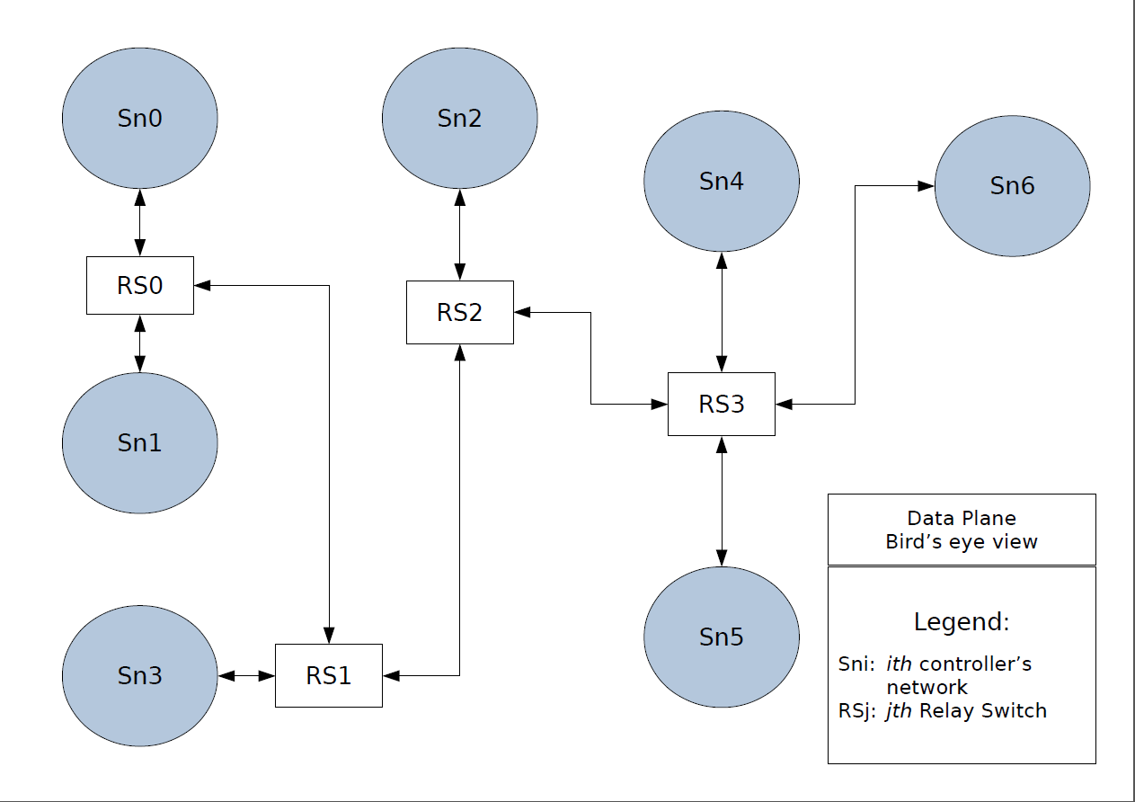

Slide 17
The New Data Plane
The data plane now consists of three separate components, namely:
  The Root Switch:
    A unique and mandatory entity for every controller subnet.
    Every host/switch within a subnet have a connection to it.
  The Relay Switch:
    The communicator between the subnets.
    n Relay Switches in whole network are connected via (n-1) connections
    Any number of subnets can be managed by a Relay Switch.
    They form a straight chain within themselves.
  A generic host:
    Represents a host which is a generic node.

Slide 18
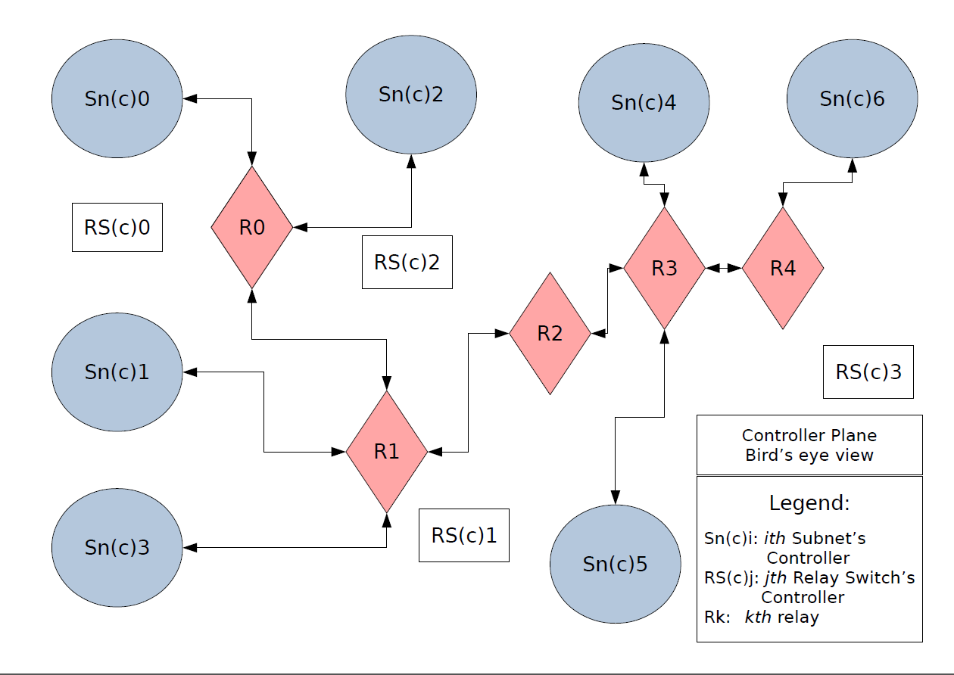

Slide 19
The New Controller Plane
The redesigned controller plane has three separate entities, namely:
  The Root Switch Controller:
    It serves as the OpenFlow controller for every controller subnet.
    Are interconnected via Relay for real time controller communication.
  The Relay:
    This is a standalone multi-threaded TCP server.
    Helps in real time connection between the Root Switch Controllers.
    Forms duplex connections to every Root Switch Controller.
  The Relay Switch Controller:
    A generic L2 learning switch controller template.
    Enforces OpenFlow protocol on the Relay Switches.

Slide 20
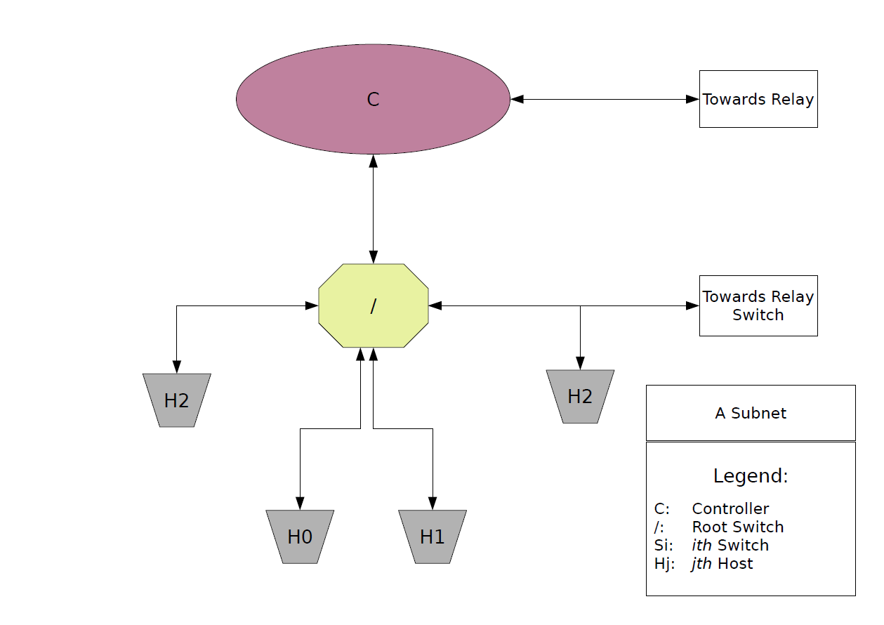

Slide 21
So what is new?
Old Topology | New Topology
Relay served as a host lookup. | Relay serves as communication entity.
Controller Plane congestion was high. | Controller plane congestion is low.
Absence of Relay Switch might result in controller flow loops (infinite). | Presence of Relay Switches mitigates controller flow loops.
Subnet planning was difficult and asymmetrical. | Due to mandated Root Switch, subnet planning is symmetric and symmetrical.

Slide 22
Lets Talk Numbers!
n(Subnets)/n(Hosts/Subnet) | Throughput (Bytes/sec) | Bandwidth (Bytes/Sec) | Delay (Hz) | Packet Loss (%) | Packet Delivery Ratio | Flow request Rate (Hz)
1/300 | 91.744 | 868.198 | 22.114 | 0.552 | 1 | (22.579)
2/50 | 95.232 | 898.652 | 7.264 | 0.525 | 1 | (25.115)(21.685)
2/150 | 95.168 | 846.332 | 22.837 | 0.526 | 1 | (23.605) (20.311)
3/50 | 94.484 | 893.565 | 10.958 | 0.559 | 1 | (22.466) (24.053)
4/75 | 95.744 | 845.227 | 23.018 | 0.586 | 1 | (19.425) (23.220)

Slide 23
Review 3

Slide 24
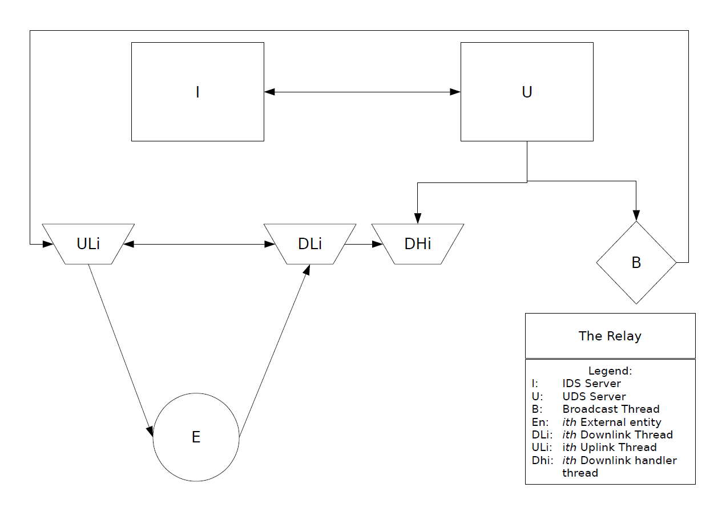

Slide 25
Addition of sub-relay in the concept
Each relay can be optionally modded into a sub-relay by supplying a file with the addresses of all the super relays it need to connect to.
The sub relay connects to the super relay and this first connection becomes the downlink connection for the super relay while being uplink for the sub relay
The sub relay creates a TCP server and listens on port 12346 which is generally on which all the root switch controllers listen on for getting a connection back from any relay.
The super relay, as in the normal code, connects back to the sub-relay, assuming it to be just another controller, hence no new exception handling code has to be written.
Now the super relay forwards information to this sub-relay too, just like it would for any other controller.

Slide 26
The sub-relay and super relay concept is oblivious to both OpenFlow version and controller. Thus backward compatibility and heterogeneity are introduced.
Thus the scalability is increased with addition of each sub-relay-super relay connection surpassing multiple geographic domains.

Slide 27
The DDoS Attack Mechanism
The topology script randomly selects a host for posing like a bad actor, on which it runs a HTTP server on port 8000 and also a TCP server on 6666 port.
A random number of hosts from the topology are then selected which fetch the vec.py (the attack vector file) from the bad acting server.
They then also form a connection to the bad acting server, which the bad actor is listening for on it port 6666.
When the topology boots up, the attack can be triggered via echoing 'trigger' in a named pipe on the bad actor system which in turn broadcasts the 'trigger' command to all its connected clients (the zombie hosts).
All the hosts then start firing up about a 1,000,000 raw ethernet frames with spoofed and randomly generated source and destination MAC addresses.

Slide 28
Whenever a spoofed raw ethernet frame hits a openVswitch, the query to route it is sent to the corresponding root switch controller, due to the non availability of the open flow entry for that particular route with the switch.
The root switch controller acts upon the receipt of such a packet query by checking the destination address and if it is found to be invalid, the controller adds a flow in the root switch controller to drop all packets that come in from this particular port, thus mitigating the attack all together.

Slide 29
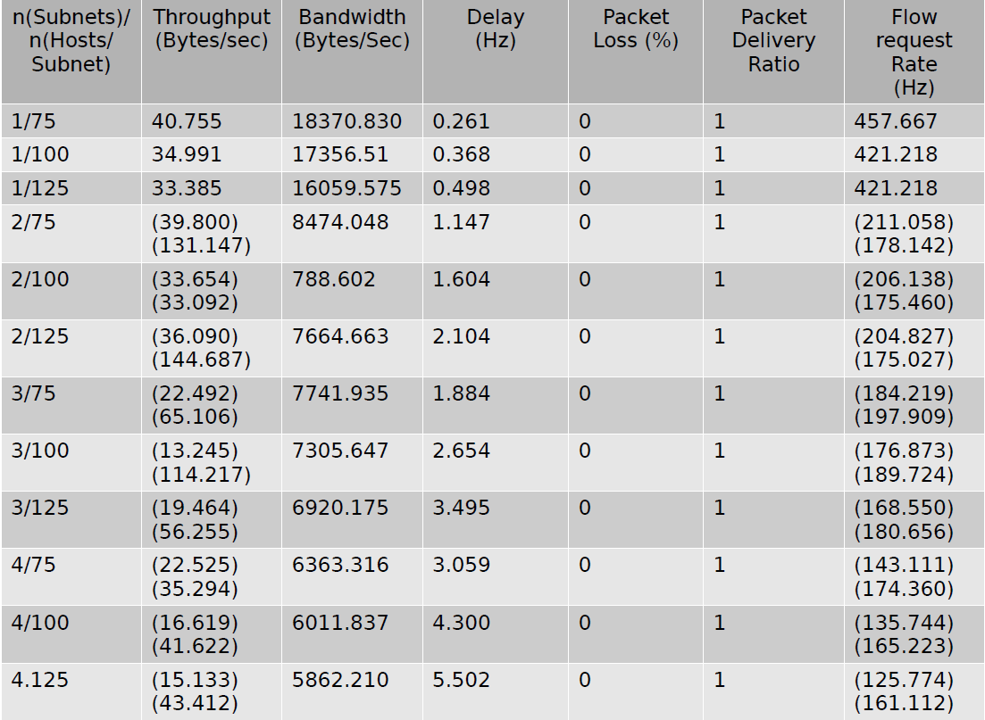
Test values to benchmark topology

Slide 30
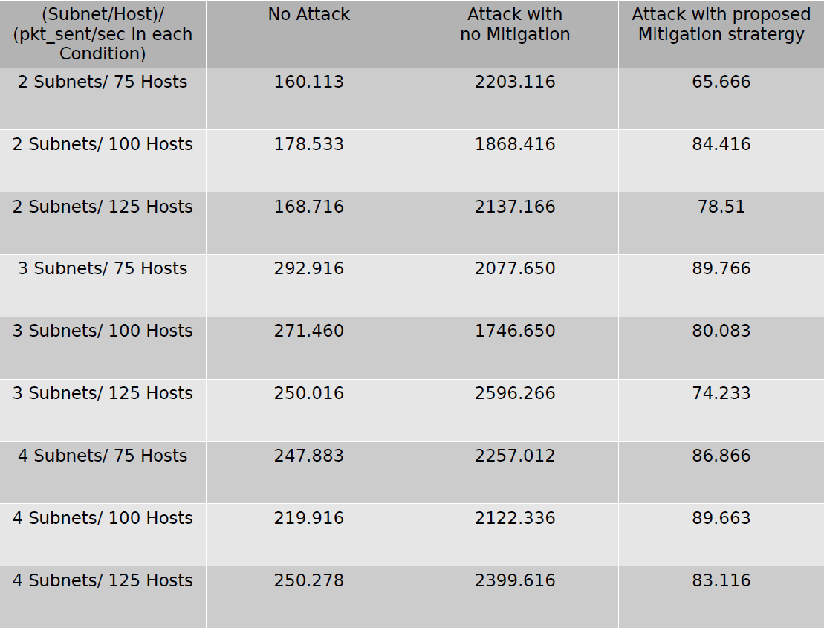
Test Values to Benchmark Attack Detection and Mitigation

Slide 31
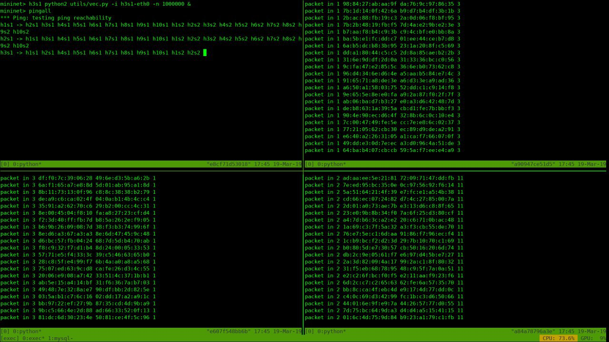
Screenshots
DoS attack

Slide 32
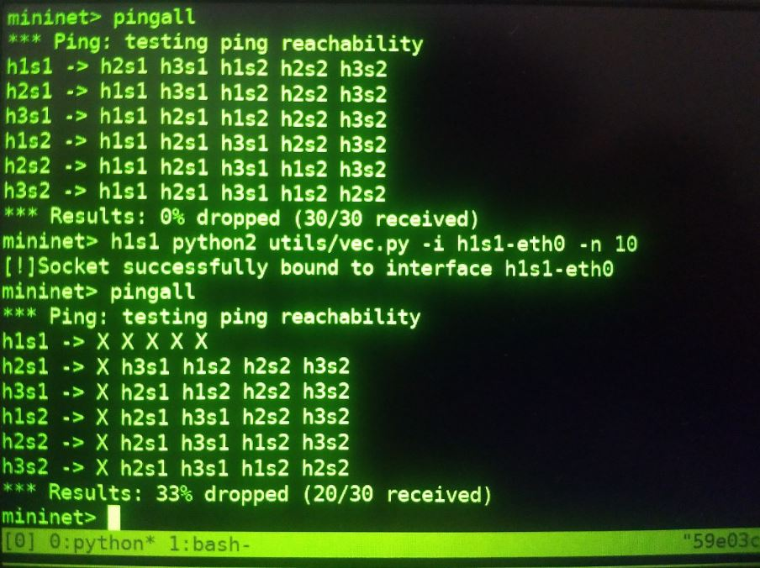
DoS Attack Mitigation

Slide 33
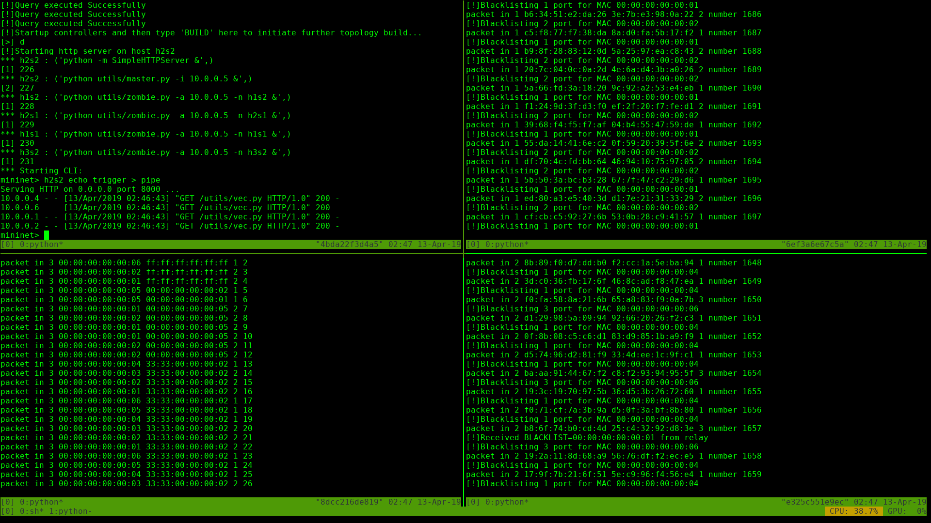
DDoS Attack

Slide 34
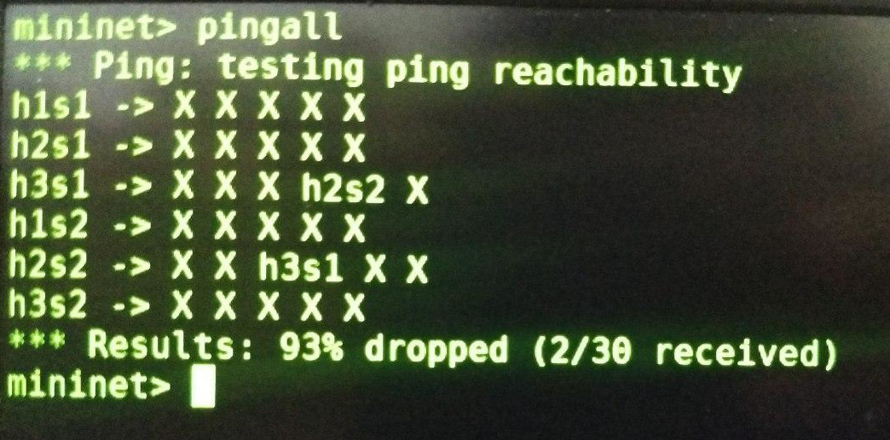
DDoS Attack Mitigation

Slide 35
Build/Execution
Environment
DevOps:
  Docker:- 18.09.1-ce
  Git:- 2.20.1
Code Compilers/Interpreters:
  GNU Gcc (Compiler):- 8.2.1
  LD (Linker):- 2.31.1
  Python:- 3.7.2
  Python2:- 2.7.15
  jdk-openJDK:- 11.0.2.u7-1
Platform:
  GNU/Linux:- Arch Linux (Vanilla)/kernel 4.20.6

Slide 36
Thank You!
Prepared and Presented by:
Naman Arora
RA1511003010235
Nikhil Gupta
RA1511003010245

